Slide 1
Software Engineering D7032E Testing and Refactoring
Teacher: Josef Hallberg

Slide 2
Unit Testing
Teacher: Josef Hallberg

Slide 3
This part of the lecture
What is unit-testing?
Why unit-test?
How much do we test?
Code example

Slide 4
Black-box testing
getRectangleArea(5,4)
public int getRectangleArea( int height, int width) { }
20
We are testing if actual output matches expected output
The test passes for getRectangleArea(5,4) = 20, and fails if not
… requirements
Black box
Actual output
compared with
required output

Slide 5
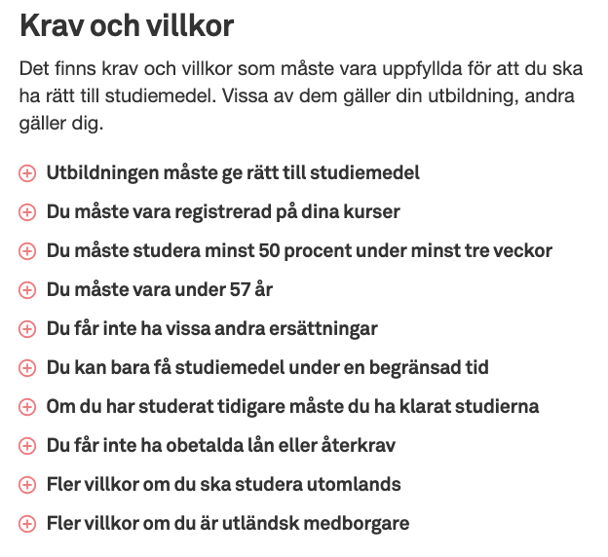
Från CSN sidan

Slide 6
Motivation
Best practices for coding:
Compile and test often
Test all branches
Don’t reintroduce old bugs
Fulfill requirements
Deliver working code

Slide 7
Why test everything?
Multiple developers
May work on different versions
Old bugs may reappear
Changing in one place
May introduce a bug somewhere else
May change the behaviour without you knowing
Unpredictable behaviour
You might have simply made an error

Slide 8
How much should we test?
As much as possible…

Slide 9
Testing Ranges: Elementary Cases
within range
2. at the boundaries
of the range
3. outside the range
(“illegal”)
range
Minimize what you need to test
or you will never stop testing!

Slide 10
Covering Every Statement is Not Sufficient
Code attempt to implement flowchart
if ( (u>1) && (v==0) ) (1)
x = x/u; (2)
if ( (u==2) || (x>3) ) (3)
++x; (4)
u=2, v=0 and x=3
executes every line (1) - (4)
gives the correct output x= 2.5
However, line (3) is wrong
What happens if u=3?
u>1 and
v==0
Yes
x = x/u
No
u==2 or
x>0
Yes
++x
No

Slide 11
Example: Legal age for purchasing alcohol
People younger than 18 may not buy alcohol
People between 18 and 20 may buy alcohol at the supermarket (3.5%), and any alcohol at a restaurant
People 20 years and older may buy alcohol at Systembolaget

Slide 12
Example: Legal age for purchasing alcohol
Pseudo code
if(age < 18) { ”may not buy alcohol” }
else if(age > 18 and age < 20) {”may buy alcohol at supermarket and restaurant”}
else if(age > 20) {”may buy alcohol at Systembolaget”}
Two bugs in this code
else if(age >= 18 …
else if(age >= 20)
So, we have to test for
age < 18
age = 18
18 < age < 20
age = 20
age > 20

Slide 13
Example: Legal age for purchasing alcohol
So, we have to test for
age < 18
age = 18
18 < age < 20
age = 20
age > 20
Time-consuming approach
Run your program 5 times:
> java AllowedPurchaseAlcohol 17
> java AllowedPurchaseAlcohol 18
> java AllowedPurchaseAlcohol 19
> java AllowedPurchaseAlcohol 20
> java AllowedPurchaseAlcohol 21

Slide 14
Unit-testing motivation
Unit-testing runs your tests automatically
Write the tests once
Test often, run in the background

Slide 15
Requirements for unit-testing
Consistency regarding input → expected output
Ability to compare output and expectation
Primitiveness (one function focuses on one thing)
Private boolean checkAvailable(x, y) {
if(rute.equals(” ”){
return true
}
return false;
}

Slide 16
Assertions
… requirements
Black box
Actual output
compared with
required output
”Assertion”
assertEquals(requirement, actual output)

Slide 17
Capture Replay Tools
Common way to automate: “GUI level macro recorders”
Scripting language – often Basic or Custom
GetEdit(), SetEdit(), ClickButton() etc.
Often give quick and easy results
Common problems:
Test maintenance
Test flakiness

Slide 18
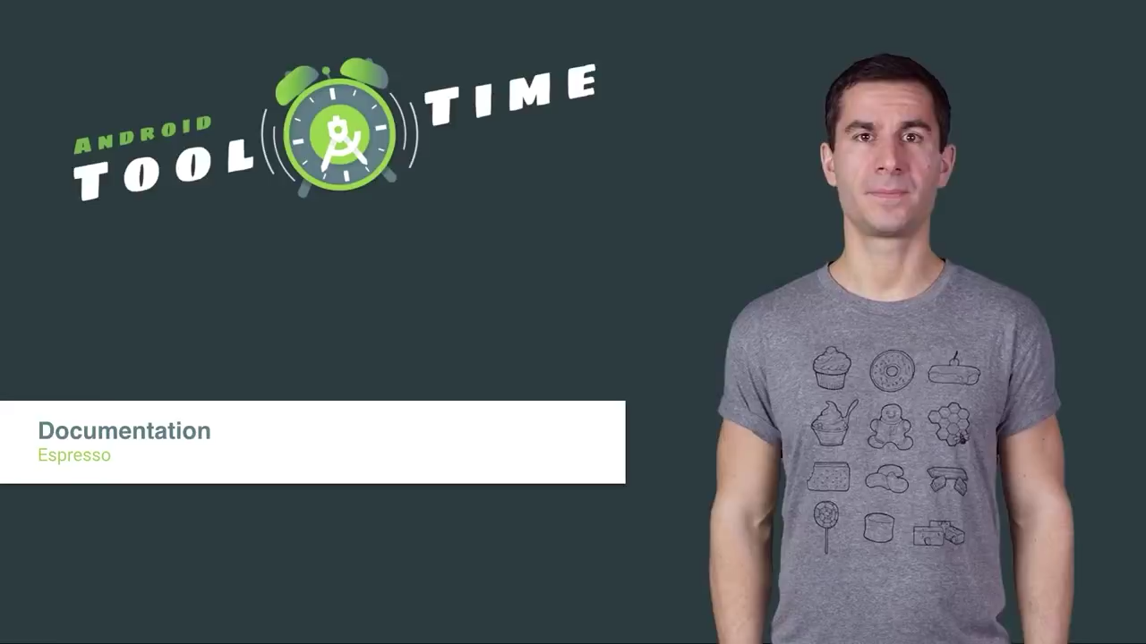

Slide 19
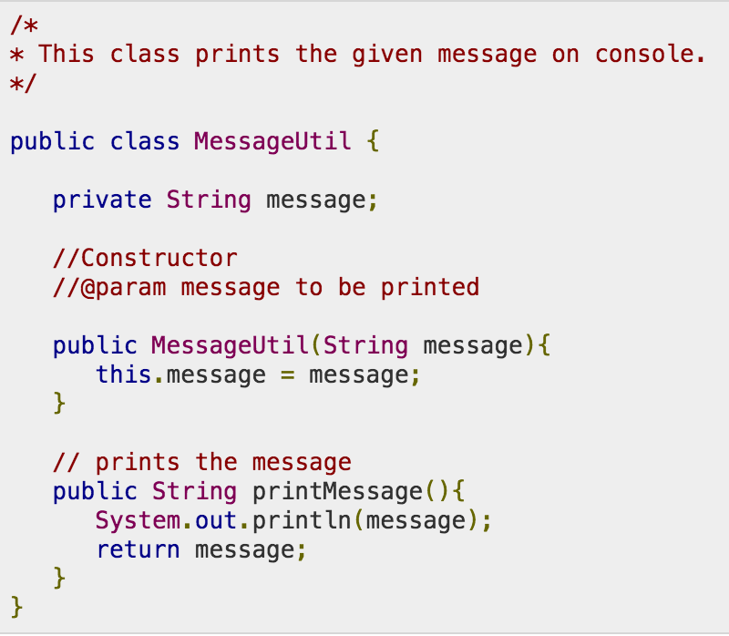
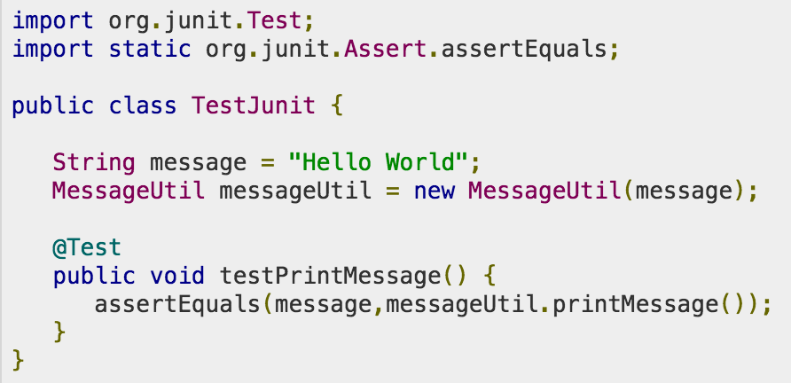
JUnit

Slide 20
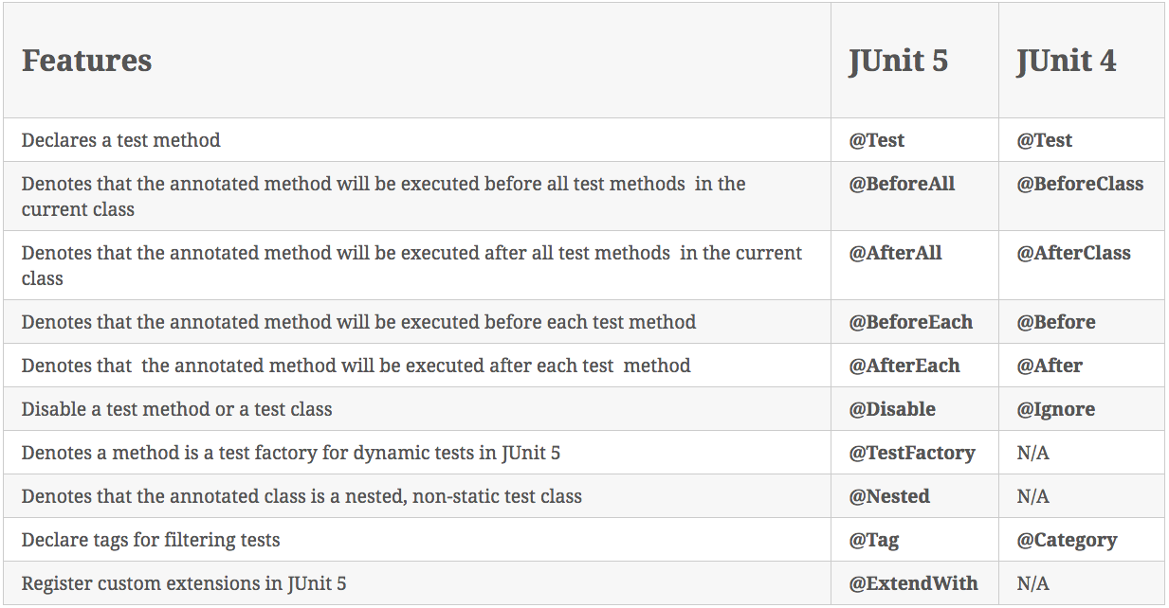
JUnit Annotations

Slide 21
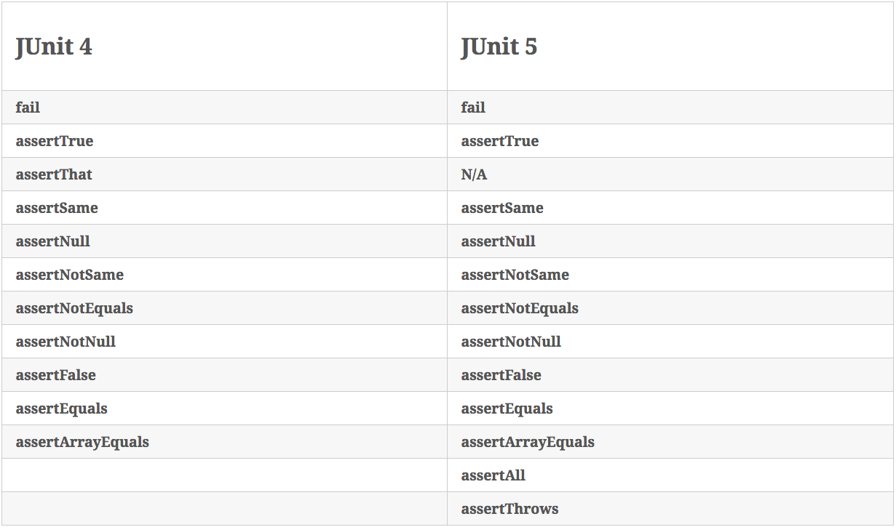
JUnit Assertions

Slide 22
assertSame / assertEquals
assertSame compares references
assertEquals runs the equals method to compare
Example: String.equals
https://docs.oracle.com/javase/9/docs/api/java/lang/String.html
If the equals method is not overriden in the classes you wish to compare, then assertSame and assertEquals work the same

Slide 23
JUnit assertion methods
…causes the current test to fail…
fail() | immediately
assertTrue(test) | if test is false
assertFalse(test) | if test is true
assertEquals(expected, actual) | if expected does not equal actual
assertSame(expected, actual) | if expected != actual
assertNotSame(expected, actual) | if expected == actual
assertNull(value) | if value is not null
assertNotNull(value) | if value is null
Can add a failure message: assertNull(“Ptr isn’t null", value)

Slide 24
Complete list of Assert
There are several variants for each assert
https://junit.org/junit5/docs/current/user-guide/
https://junit.org/junit4/javadoc/4.13/org/junit/Assert.html
https://junit.org/junit5/docs/5.9.1/api/org.junit.jupiter.api/org/junit/jupiter/api/Assertions.html

Slide 25
A few general hints
Test one thing at a time per test method
10 small tests are much better than one large test
Be stingy with assert statements
The first assert that fails stops the test – provides no information about whether a later assertion would have failed
Be stingy with logic
Avoid try/catch – if it’s supposed to throw an exception, use expected= (or assertThrows() in Junit5)... if not, let JUnit catch it

Slide 26
Test case dangers
Dependent test order
If running Test A before Test B gives different results from running Test B then Test A, then something is likely confusing and should be made explicit

Slide 27
JUnit and exceptions
Testing for exceptions @Test(expected = ArrayIndexOutOfBoundsException.class) public void testBadIndex() { ArrayIntList list = new ArrayIntList(); list.get(4); // this should raise the exception } // and thus the test will pass
@Test void testExpectedException() { NumberFormatException thrown = Assertions.assertThrows(NumberFormatException.class, () -> { Integer.parseInt("One"); }, "NumberFormatException was expected"); Assertions.assertEquals("For input string: \"One\"", thrown.getMessage()); }

Slide 28
Example: Legal age for purchasing alcohol
People younger than 18 may not buy alcohol
People between 18 and 20 may buy alcohol at the supermarket (3.5%), and any alcohol at a restaurant
People 20 years and older may buy alcohol at Systembolaget

Slide 29
1 out of 4 branches missed
if(age<18) {
return "may not buy alchol";
} else if(age>=18 && age<20) {
return "may buy alcohol at the supermarket and at restaurants";
} else {
return "may buy alcohol at Systembolaget";
}
Age=17 : false && true (but a different test)
Age=18 : true && true
Age=19 : true && true
Age=20 : true && false
Age= ? : false && false? (age < 18 but at the same time > 20… twilight zone)

Slide 30
Example
Is it designed for testability?
Metrics?

Slide 31
Refactoring

Slide 32
Software Re-engineering - Theoretical and Practical Approaches
"Any fool can write code that a computer can understand. Good programmers write code that humans can understand." - Fowler et. al.

Slide 33
Structure of Presentation
Some Theory
Basic knowledge of Re-engineering
Example
How one can use the Theory
Conclusions
Summary
Lessons Learned

Slide 34
Theory
Basic knowledge of Re-engineering

Slide 35
Some Basics
Software Component
Replaced or changed as the system evolves
Individual interface
Encapsulates internal details
Separate documentation
Software Module
Implementation unit
Independently developed
Do not need each other to function

Slide 36
Lehman’s Laws
Program evolution
The Law of Continuing Change
A program that is used in reality must change, or become progressively less useful.
The Law of Increasing Complexity
As a program evolves, it becomes more complex. This will continue until work is done to maintain or reduce the complexity.

Slide 37
What is Re-engineering?
Understand and then improve existing software system
Examination > Analysis > Alteration
Does not change the functionality
Three basic steps:
Reverse engineering
Restructuring/Refactoring
Forward engineering

Slide 38
Why Re-engineering?
Make the system “better”!
More maintainable
Easier to understand
Better performance
Cope with changes outside the system
New software
New hardware

Slide 39
Re-engineering Steps
1. Reverse engineering
Analyze components and their relationships.
Creates a description of the system
The more complex a program is the harder it is to reverse engineer

Slide 40
Re-engineering Steps
2. Refactoring/Restructuring
(x - 1) * (x + 1) = x^2 - 1
Does not change the external behavior
Not same as Rewriting
Rewriting changes the behavior
Improve the design of the code after it has been written

Slide 41
Re-engineering Steps
3. Forward engineering
Move from abstract or high implementation-independent design to a physical implementation of a system
This is the traditional way of designing systems
You know this stuff by now… ;)

Slide 42
Re-engineering: Different levels
Source Code Level
Change structure
Improve algorithms
New language porting
Function Level
Updates to the Class (if OO)
Interface changes (ex Method names)
Architecture Level
Types of components
Interactions between components
Modules

Slide 43
New level needed?
If we fail to understand the architecture of the system
What to do? Can we abstract further?

Slide 44
New level needed?
If we fail to understand the architecture of the system
What to do? Can we abstract further?
New abstraction level: Intentions level
What the system is supposed to do
Abstraction level that captures the essence of the application
Can be seen as a start of a new architecture

Slide 45
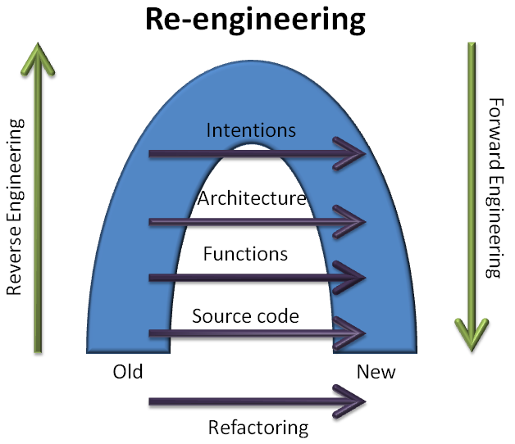
Re-engineering Model

Slide 46
Reverse Engineering: Problems at Architecture Level
Insufficient documentation
Documentation either does not exist or is not up to date
Improper layering
Missing or improper layering decreases portability and adaptability
Lack of modularity
Strong coupling between modules hinders evolution
Duplicated code
It is quick to copy-paste code, but it is really bad for maintenance.
Duplicated functionality
Similar functionality exists in several places of the code.

Slide 47
How to Refactor?

Slide 48
How to Refactor?
Do NOT do it all from scratch!

Slide 49
How to Refactor?
Do NOT do it all from scratch!
Save Time, reuse Knowledge
Use existing Tools and Techniques

Slide 50
How to Refactor?
Do NOT do it all from scratch!
Save Time, reuse Knowledge
Use existing Tools and Techniques
Because key point is to:
Increase cohesion
Decrease coupling
Modularize system parts
Decrease class sizes
Better Class- and Method-names
And so on

Slide 51
Refactor: Existing Knowledge and Tools
Design principles
Fundamentals in software areas
Design Patterns
Reusable software designs
Build on design principles
Frameworks
Skeleton for an application
Many exists in vastly different areas
Often uses existing Design Patterns

Slide 52
Refactor: Different Levels
Different Design Patterns on different levels
Architectural Patterns on higher levels
Can do Refactoring at lower levels
Fowler (see next slide) promotes this

Slide 53
Refactor: Low Levels
Check out Refactoring catalog
http://refactoring.com/
Tons of Refactoring on this site!
Many things really basic IF you know basics, principles and patterns
Example:
You have two classes with similar features
Create a superclass and move the common features to the superclass

Slide 54


Software Framework
Dictates the architecture of an application
Components
Flow of control
Design parameters: what to change
Hot spots
Where developer change
Frozen spots
Hidden from normal development

Slide 55
Real Life Example
One of my student’s Thesis Works

Slide 56
Thesis Purpose
Re-engineer a web application
To follow good system design
Make program source code easier to:
Understand
Update
Expand
Other words: Increase maintainability and understandability

Slide 57

MemoryLane
Life-logging
Digitally record aspects of one's life
Web application
PHP programming language
Review activities
Digitally stored pictures grouped into activities
Support people with dementia
Remember their day

Slide 58
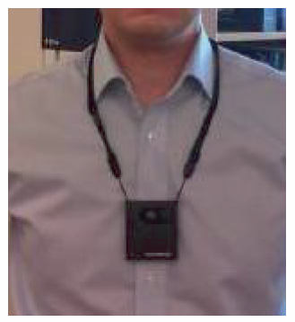
Camera for life-logging

Slide 59
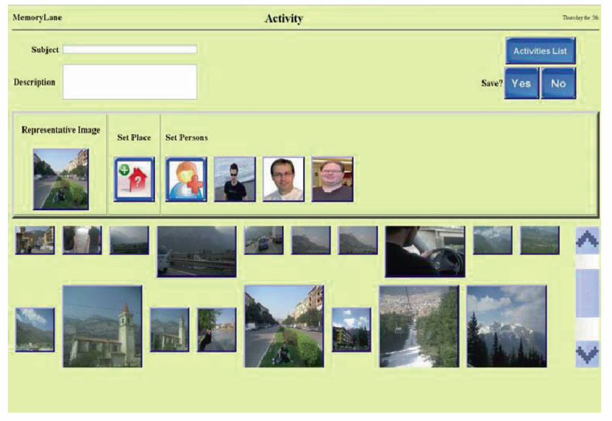
MemoryLane: Create activity

Slide 60
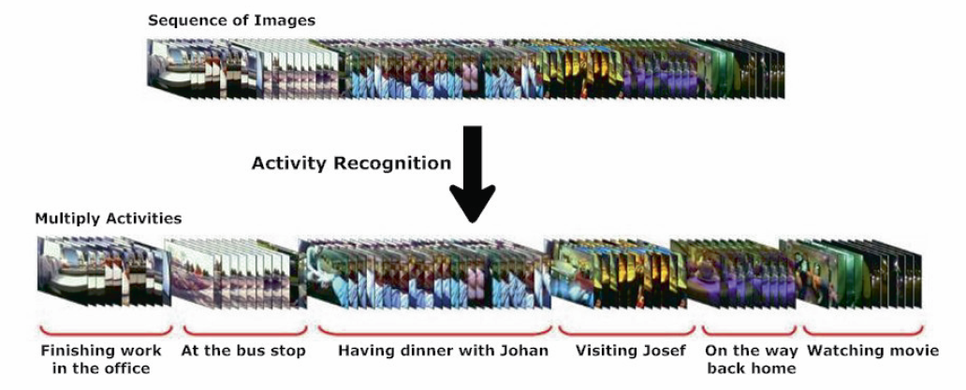
MemoryLane: Activity Recognition

Slide 61

MemoryLane: First looks…
First look on the source code for the MemoryLane application

Slide 62
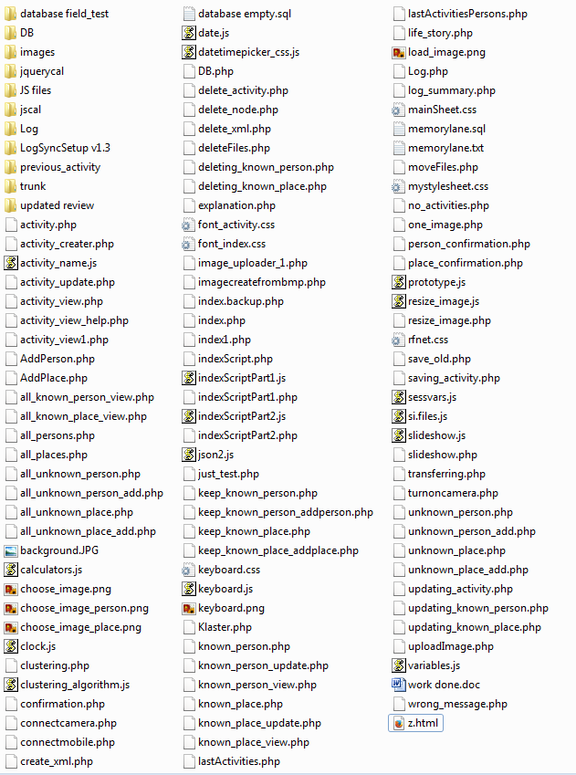

Slide 63
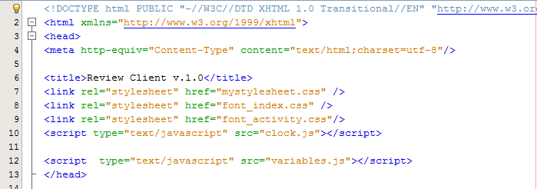

Slide 64
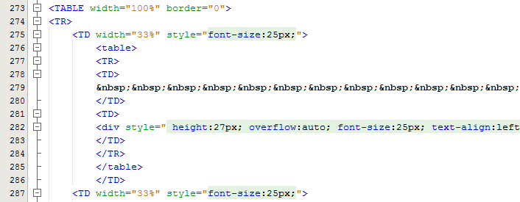

Slide 65
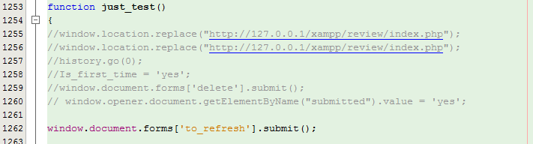

Slide 66
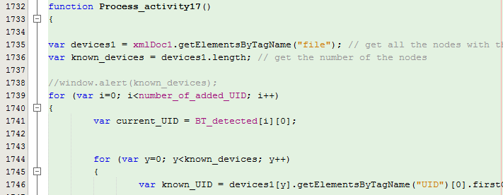

Slide 67
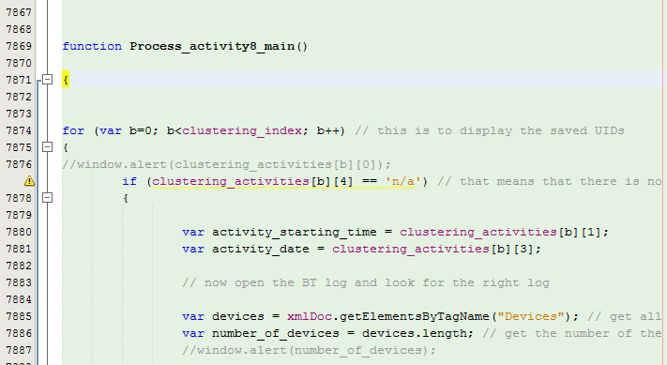

Slide 68
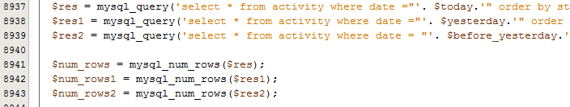

Slide 69
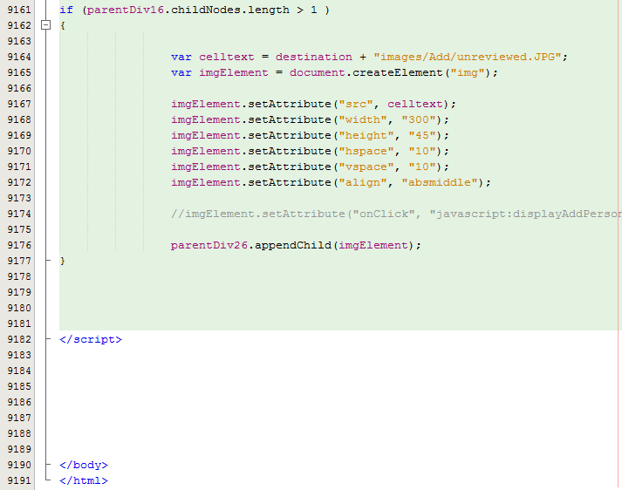

Slide 70
Example Re-engineering
Uh-oh! Alot of problems:
No documentation
No layers
Lack of modularity
Duplicated functionality and code
Example: Database login done in 59 different files.
Very hard to refactor at lower abstraction levels!

Slide 71
Example: Reverse Engineering
Big Bang Approach
Rebuild whole system.
Represent at the Intentions level. How?
Features:
A feature is a realized functional requirement for a system.
It can be seen as an observable behavior of the system that can be triggered by a user.
Can keep external behavior of the system.

Slide 72
Example: Refactoring
Keep functionality intact with features
Refactoring in big steps
Once Big Bang all done:
Refactor my new code in small steps
Can be an iterative process

Slide 73

Example: Forward Engineering
Documentation
Architecture docs.
Design Patterns and Principles
MVC, Separation of Concerns, Dependency Injection, etc…
Build on other’s experience
No duplicated functionality or code
Component based object oriented system through frameworks.

Slide 74


Example: Frameworks
Zend Framework 2 (ZF2): Web Framework
Open source PHP
Object-Oriented
MVC: Different layouts
Modules: Easy to add independent components
Doctrine 2 Object Relational Mapping
Mapping the records of a relational database into the object-instances
Complex to build, easy to use.

Slide 76
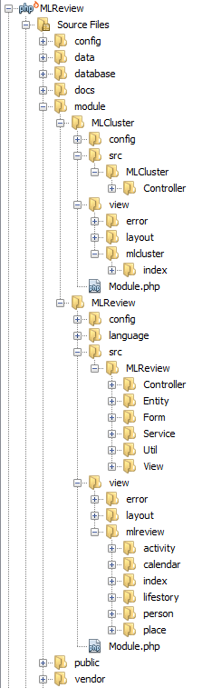

Slide 77
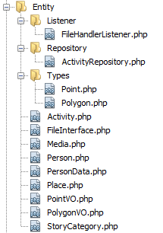
New MemoryLane: Model

Slide 78
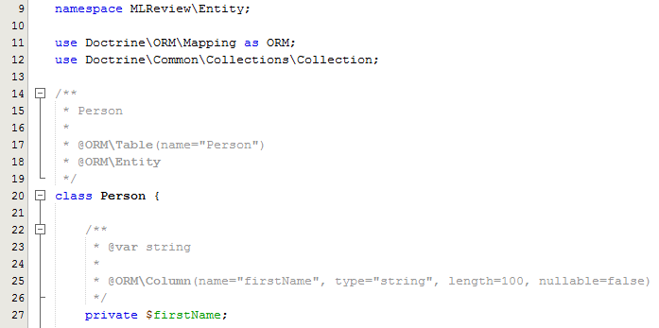
New MemoryLane: Model

Slide 79
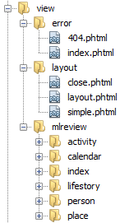
New MemoryLane: View

Slide 80
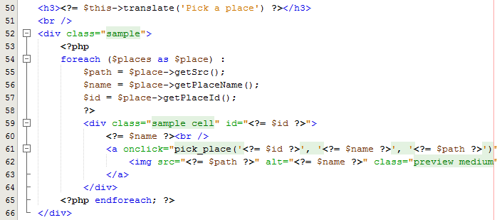
New MemoryLane: View

Slide 81
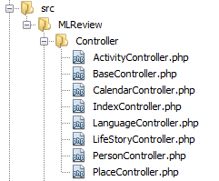
New MemoryLane: Controller

Slide 82
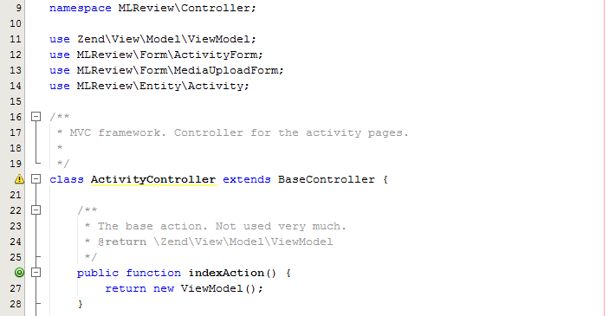
New MemoryLane: Controller

Slide 83
Uh-huh, but is it ”better”?
If we can show that the maintainability and understandability is better, the new application should be better.
From a non-functional re-engineering point of view
Very hard to prove it is better
“It feels better”, might not cut it

Slide 84
Thesis: Code Complexity
Code complexity
Difficulty of maintaining, changing and understanding an application.
Greater complexity => less maintainable and understandable code
Lines of Code (LOC)
Count of lines of source code not including comments or blank lines.
Dependent on programming language.

Slide 85
Thesis: Lines Of Code (LOC)

Slide 86
Thesis: LOC with Frameworks

Slide 87
Since then it has re-engineered again into Django
A lot of administration functionality for free

Slide 88
Conclusions
Summary
Lessons Learned

Slide 89
Summary: Re-engineering
Do not do it from scratch, use:
Existing knowledge
Design Principles
Design Patterns
Existing tools
Frameworks
Techniques

Slide 90
Summary: Working steps
Three basic steps:
Reverse engineering
Restructuring/Refactoring
Forward engineering
Do not be afraid to use your own technique or model!
Needs to fit the project at hand
Example: No Architecture -> Work from Intentions Abstraction Level

Slide 91
Summary: Thesis Example
Transforming the static implementation to an open, modularized, and flexible platform.
Using Re-engineering
Model-View-Controller layering
Frameworks like the Zend Framework 2 and the Doctrine 2 ORM.
Code complexity analysis
New application should have a better understandability and maintainability

Slide 92
Lessons Learned
Build on other’s shoulders
Do not reinvent the wheel
Document important stuff
Comments in code
Later developers will thank you
Conservation of Familiarity
So easy to miss

Slide 93
Lehman’s Laws again…
Conservation of Familiarity
As a system evolves, developers must maintain mastery of its content and behavior to achieve satisfactory evolution.
Without a familiarity of how and why the system was designed in the way it was, it becomes very difficult to implement changes to it without compromising the ability to understand it.

Slide 95
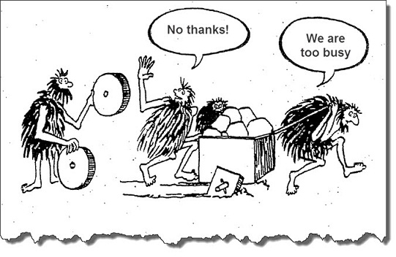

Slide 96
The End
Questions?

Slide 97
Appendix

Slide 98
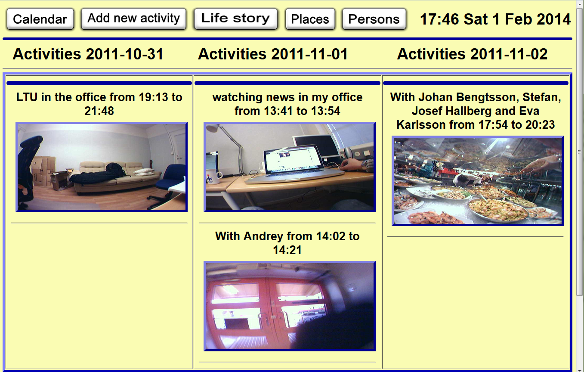
Old prototype

Slide 99
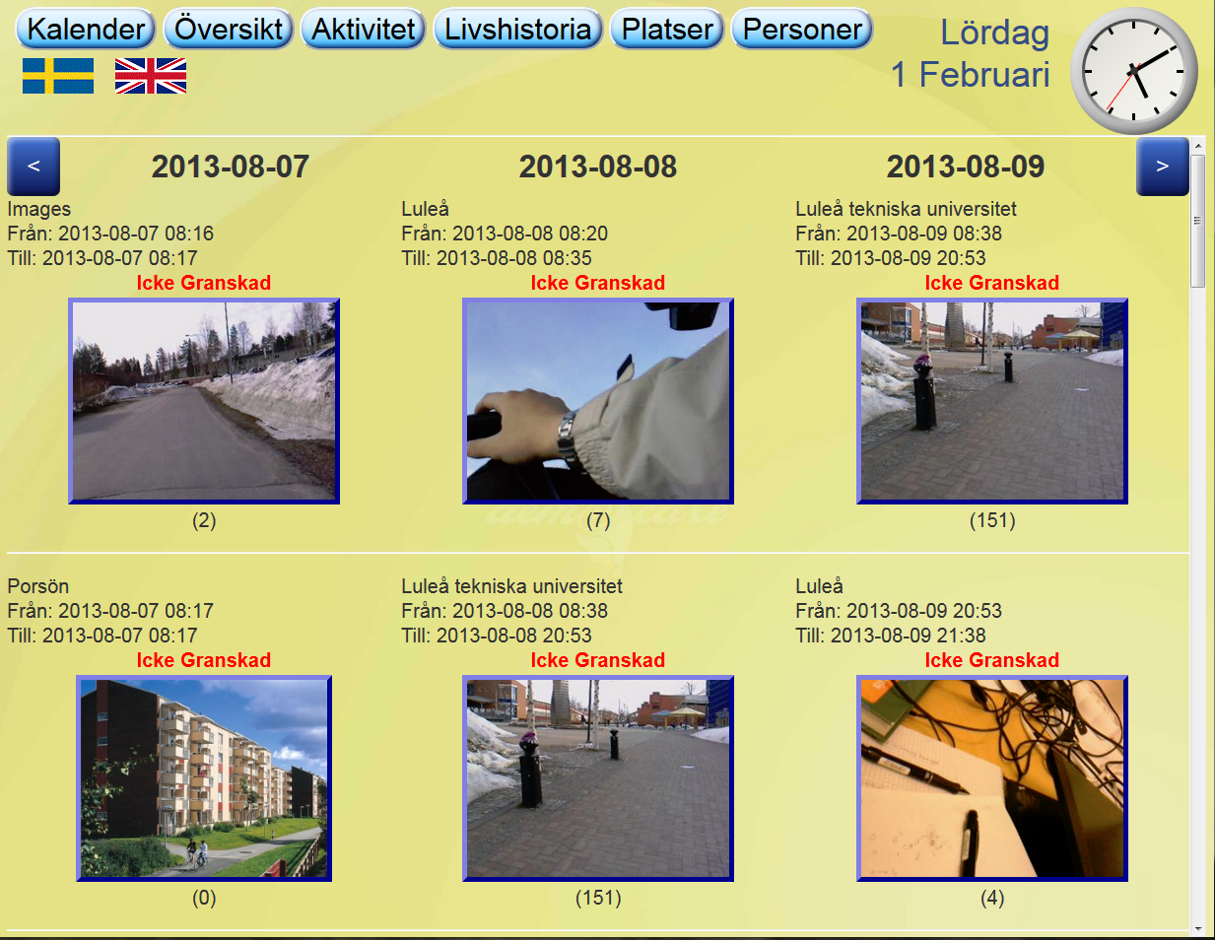
New prototype

Slide 100
OO Design Principles
Single responsibility principle
Open/closed principle
Liskov substitution principle
Interface segregation
Dependency inversion principle

Slide 101
OO Design Principles
Single responsibility principle
A class should have only a single responsibility
Only one potential change in the software's specification should be able to affect the specification of the class
Open/closed principle
Software entities should be open for extension, but closed for modification

Slide 102
OO Design Principles
Liskov substitution principle
Objects in a program should be replaceable with instances of their subtypes without altering the correctness of that program
Interface segregation
Many client-specific interfaces are better than one general-purpose interface

Slide 103
OO Design Principles
Dependency inversion principle
Depend upon Abstractions. Do not depend upon concretions
Dependency injection is one method of following this principle

Slide 104
Example: Design Pattern
Dependency Injection (DI)
Builds on”Inversion of Control”
Design Principle
Also called ”The Hollywood Principle”
Don't call us, we'll call you!
Difference between Framework and Library
Increases Modularity (Design Principle)
Increases Extensibility (Design Principle)

Slide 105
Design Pattern: Dependency Injection
Definition
Dependency Injection: Authoritative component inject any dependencies into other components.

Slide 106
Design Pattern: Dependency Injection
Definition
Dependency Injection: Authoritative component inject any dependencies into other components.
Wait…WHAT??

Slide 107
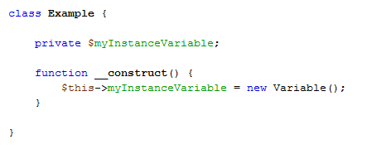
Example Design Pattern: Without Dependency Injection

Slide 108
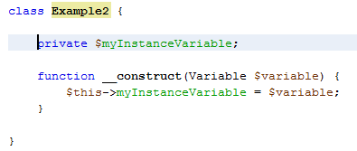
Example Design Pattern: With Dependency Injection

Slide 109
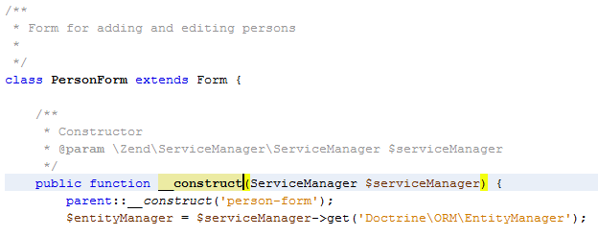
RL Implementation: Service Locator with DI
Service Locator: An object that knows how to get hold of all the services needed by the application.

Slide 110
Questions?

